Slide 1
Storyboard Introduction

Slide 2
What A Storyboard Needs:
Images/Sketches – Rough drawings showing characters, backgrounds, or objects.
Frames/Panels – Boxes that represent shots or scenes.
Action Description – Notes about what happens in the shot (movement, expressions, etc.).
Dialogue/Audio – Words spoken, sound effects, or music cues.
Camera Directions – Notes like close-up, zoom, pan, fade in/out. (These are helpful for bigger projects)
Timing – Optional, but helps estimate length of each shot.

Slide 3
How to Make a Storyboard:
Define the story – Break it down into key scenes (beginning, middle, end).
1
Decide on shots – What camera angles or perspectives will best tell each moment?
2
Draw frames – Simple stick figures are fine—don’t worry about being a great artist.
3
Add notes – Dialogue, actions, sound, and camera movement.
4
Review and adjust – Make sure the flow makes sense before production.
5

Slide 4
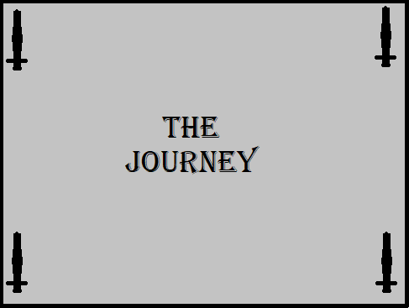
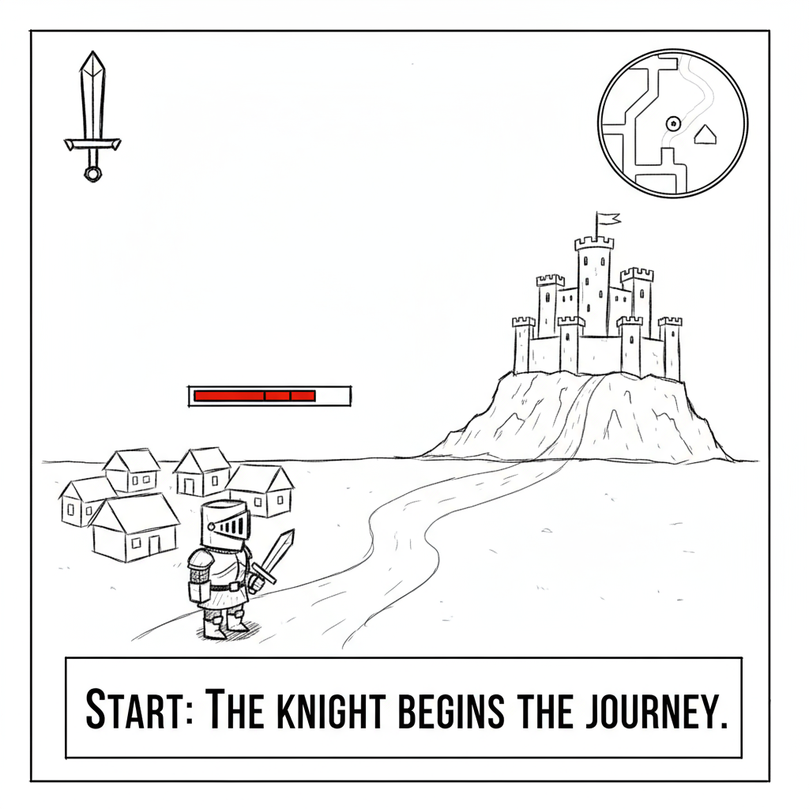
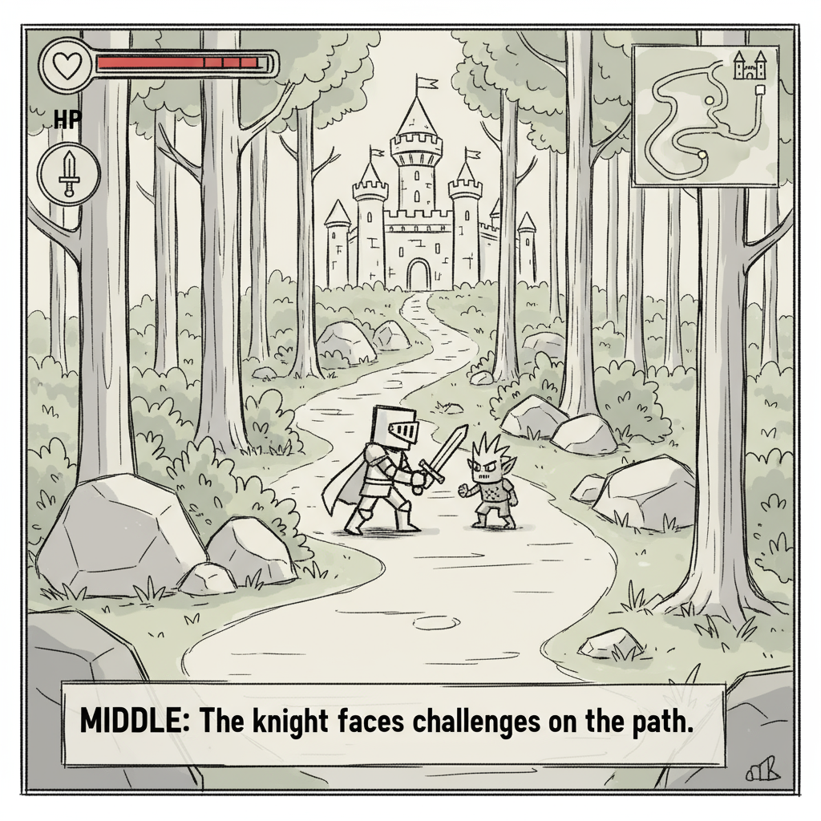
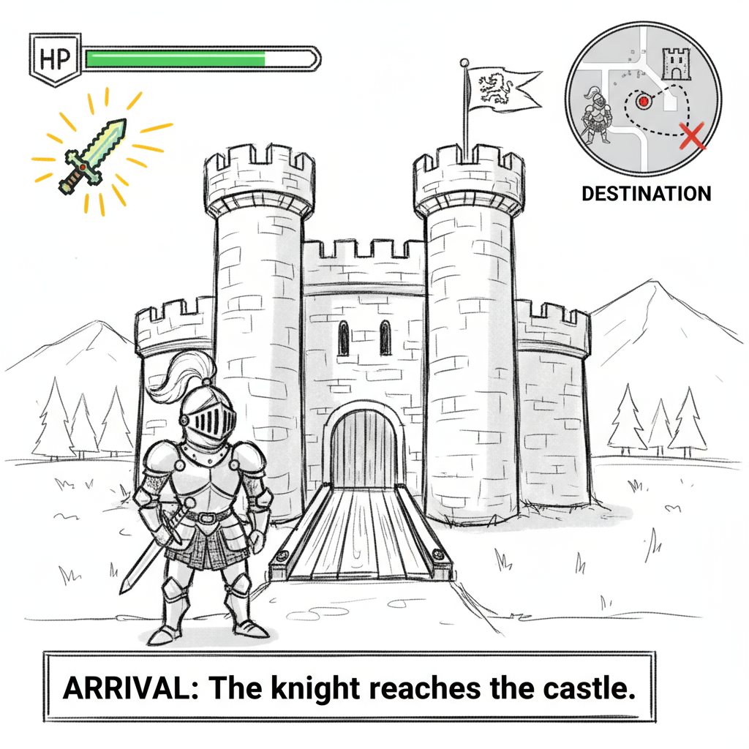
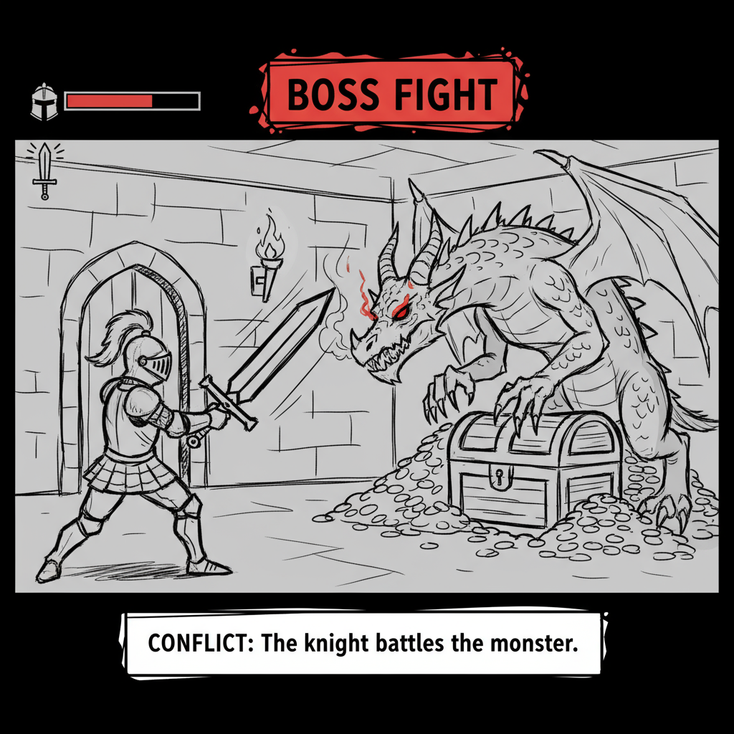
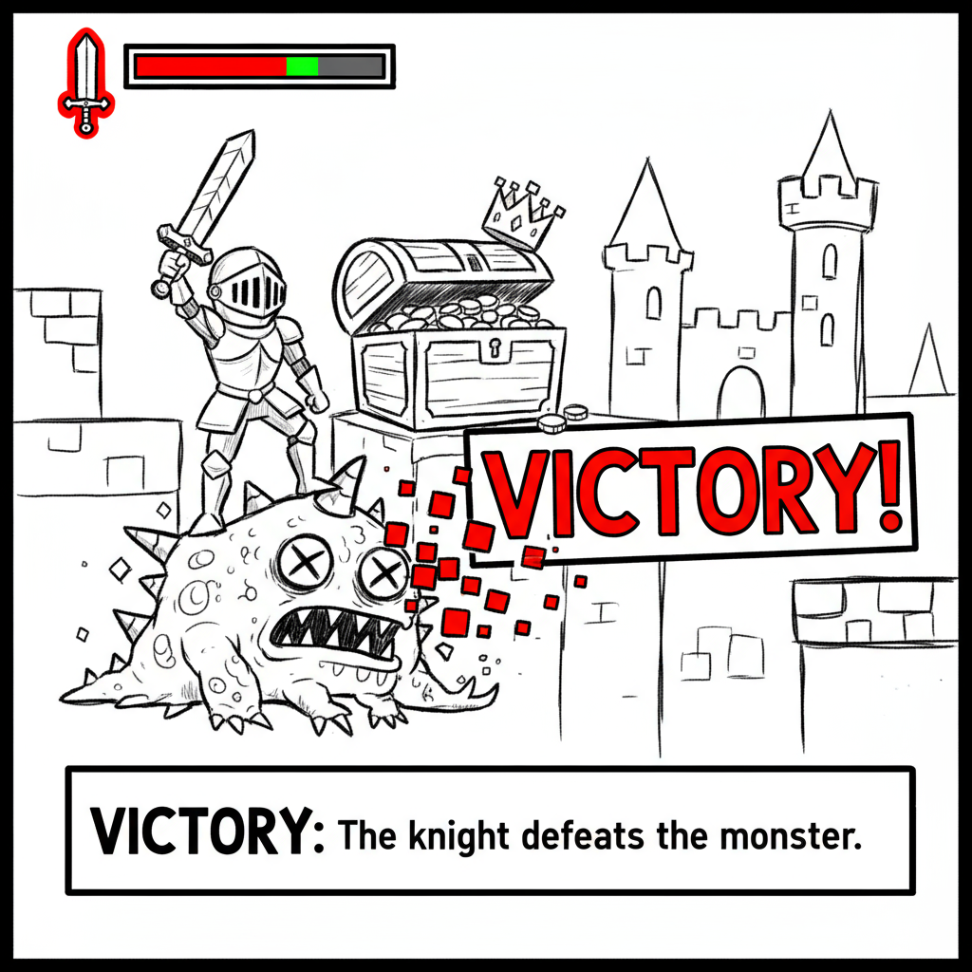
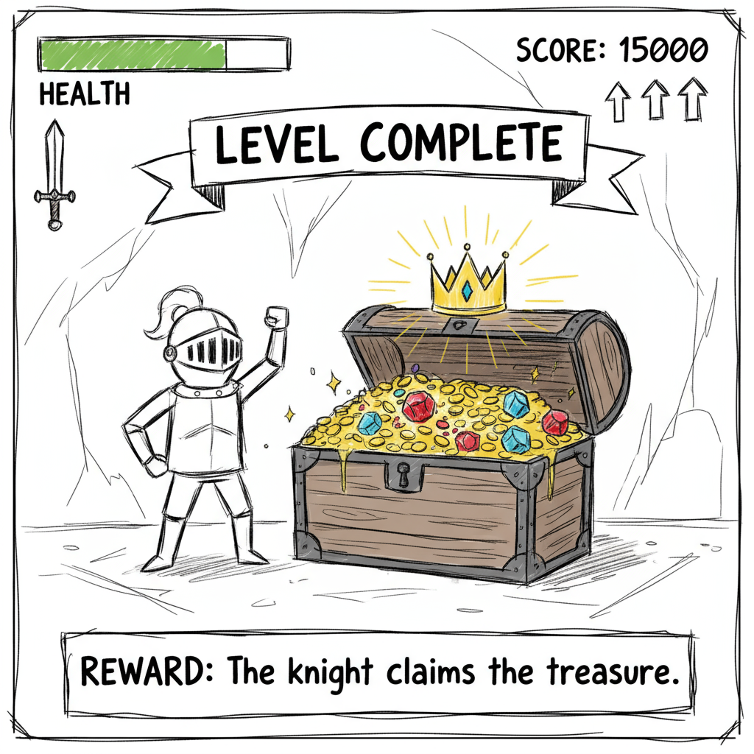
Example of a Storyboard

Slide 5

Action: Knight leaves the village, waving goodbye to villagers. Castle visible in the distance. Dialogue: Knight: “It’s time to prove my courage!” Villager: “Good luck, brave knight!” Notes: Background: village with cottages, dirt path leading to distant castle.
Scene 1:
Scene 2:
Action: Knight walks through a forest, and gets ambushed by enemies. Dialogue: Knight (thinking): “These woods are trickier than I imagined…” Notes: Include rocks, tall trees, maybe a small enemy.

Slide 6
Action: Monster/dragon appears, blocking the treasure room. Knight prepares for battle. Dialogue: Knight: “I won’t back down!”
Monster: “Who dares enter my lair?”
Notes: Include tension-building elements like shadows, roaring sound effects.
Scene 3:
Scene 4:
Action: Knight reaches castle gates, looking up at the towers. Dialogue:
Knight: “At last… the castle!” Notes: Dramatic perspective showing castle height.

Slide 7
Action: Knight opens treasure chest, shining treasure inside. Knight smiles. Dialogue:
Knight: “All my efforts have paid off!” Notes: Background: castle interior, treasure sparkling.
Scene 5:
Scene 6:
Action: Knight strikes the monster with sword, monster falls. Dialogue:
Knight: “Victory is mine!” Notes: Dramatic poses, sigh of relief

Slide 8
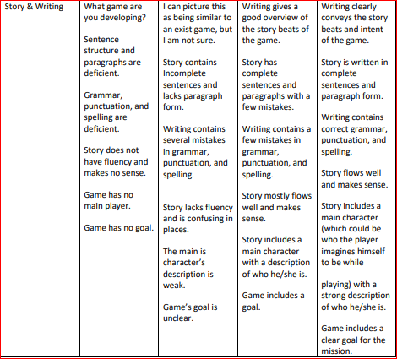
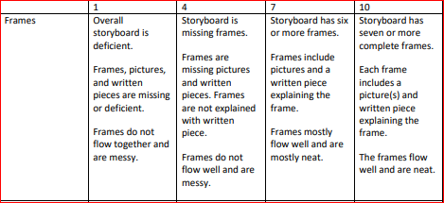
Marking Key for Storyboard:

Slide 9
Use Case Diagram Introduction

Slide 10
How to Make a Use Case Diagram:
Identify Actors – Who is going to be using this product?
1
Identify Use Cases – Find the main functionalities of your system, each use case represents a functionality.
2
Connect Actors to Relevant Use Cases – Identify connections between actors and use cases and draw a line to connect them.
3
Connect Use Cases to Other Use Cases – Identify connections between use cases and connect them with an <<extend>> or <<include>> arrow.
4
Review – Make sure the diagram makes sense and includes all functionality and actors.
5

Slide 11

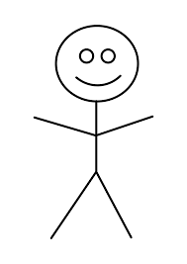
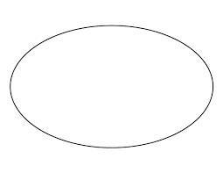
Elements in a Use Case Diagram
Actor
Use Case
System Boundary

Slide 12
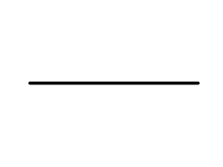
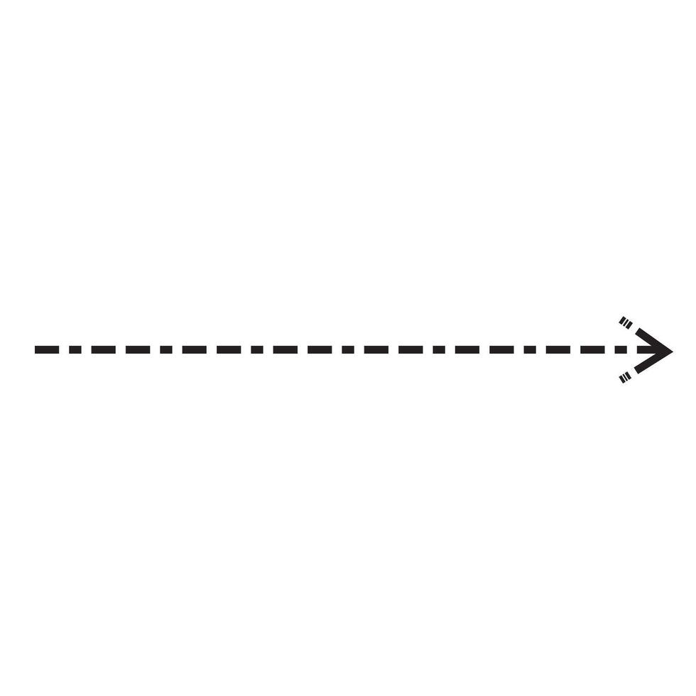

Connections in a Use Case Diagram
Association
Include
<<include>>
Extend
Generalization
<<extend>>

Slide 13
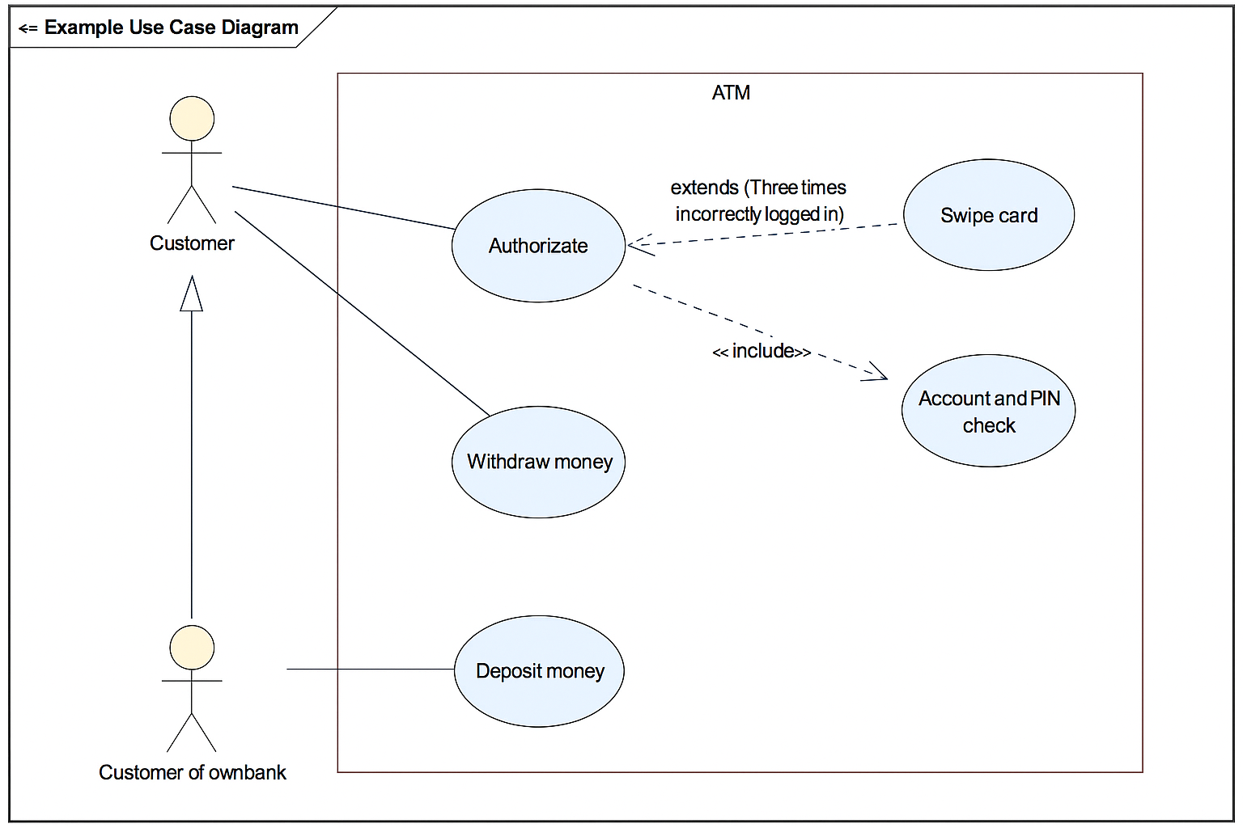
Example of a Simple Use Case Diagram

Slide 14
Use Case Diagram Tips/Tools
Keep it as simple as possible without missing any functionality
Make deliberate connections
Ensure elements and connections look uniform
Tools: Lucidchart, draw.io, or anything that can draw a stick figure and circles

